Slide 1
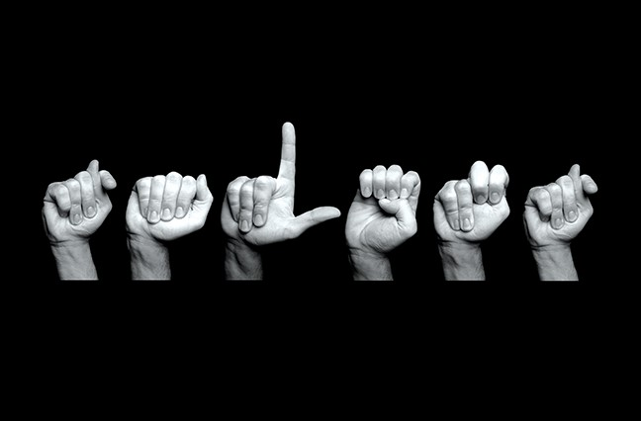
Sign Language Detection Innovative TensorFlow Technology

Slide 2
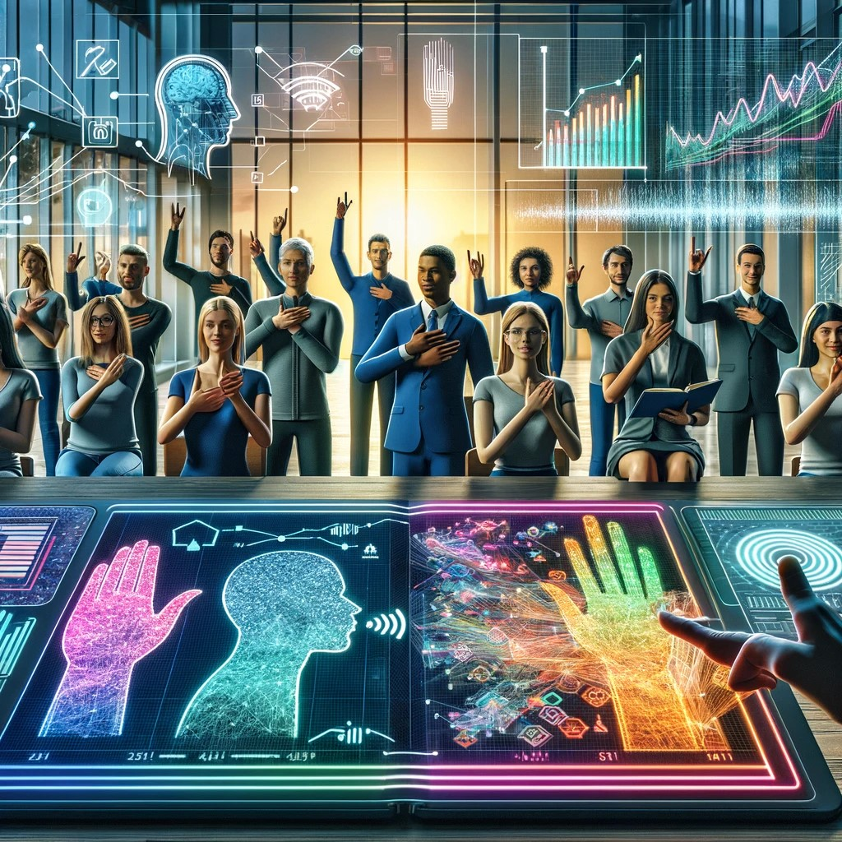

Slide 3
Exploring Real Time Sign Language Detection
Real-Time: We use the latest technology to detect sign language right as it happens.
Detection: We apply advanced methods to correctly understand sign language movements quickly.
Tensor Flow: This powerful tool helps us make sign language detection faster and more accurate.

Slide 4
Problem Statement Overview
Accuracy
Speed
Model complexity
Integration with existing technologies.

Slide 5
Flow
Clone repo
Collect images and code for training
Setup labelling and label images
Update label map
Train
Update check point
Detect

Slide 6
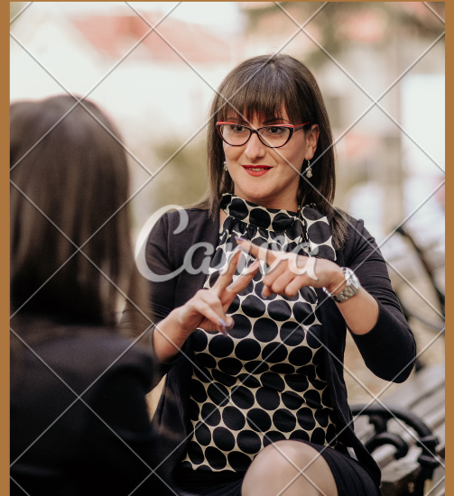
Revolutionizing Sign Language Communication Using TensorFlow
Not only Empowering the deaf community through real-time sign language detection but also it is a necessity that technology like Tensor Flow can help us achieve."

Slide 7

Sign Language Technology
This section explores the innovative use of TensorFlow for real-time sign language detection, revolutionizing accessibility and communication for the hearing impaired community.

Slide 8

Real Time Sign Language Detection
Exploring the innovative use of TensorFlow for real-time sign language detection, revolutionizing communication accessibility for the hearing impaired community.

Slide 9
Tensorflow object detection
Framework: Built on TensorFlow to help develop, train, and deploy object detection models.
Pre-trained Models: Includes models like SSD, Faster R-CNN, and others optimized for different use cases.
Customization and Training: Supports training on custom datasets with adjustable architectures and parameters.
Integration: Works seamlessly with TensorFlow's broader ecosystem, including TensorFlow Lite and TensorFlow Serving.

Slide 10
SSD (Single Shot MultiBox Detector)
SSD (Single Shot MultiBox Detector):
Overview: A popular deep learning model for object detection known for its speed and efficiency.
Architecture: Utilizes a single deep neural network to detect multiple objects within the image in one go.
Performance: Balances speed and accuracy, making it suitable for real-time processing.
Training: Typically trained on standard datasets like PASCAL VOC and COCO, with the ability to be fine-tuned on custom data.

Slide 11
TensorFlow
TensorFlow:
Deep Learning Framework: Open-source library developed by Google, widely used for machine learning and neural network research.
Flexibility: Supports both research and production, with capabilities to move from model development to deployment on various platforms.
Ecosystem: Includes tools for model building (TensorFlow Core), simplified APIs (like Keras), and specialized libraries for mobile devices (TensorFlow Lite) and large-scale deployment (TensorFlow Serving).
Community Support: Benefits from extensive community contributions, tutorials, and documentation, facilitating a wide range of machine learning applications.

Slide 12
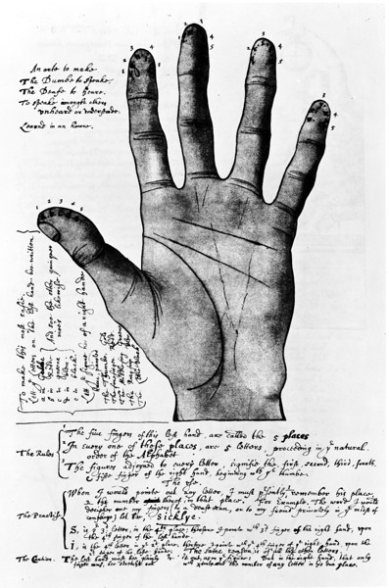
overview
Purpose and Impact: Enhance communication for the deaf by translating sign language in real time, helping to bridge communication gaps.
Technology Used: Uses Tensor Flow, a powerful machine learning framework, to improve the accuracy and speed of sign language detection.
Detection Techniques: Employs advanced methods to accurately interpret various sign language gestures quickly.

Slide 13

Applications: Focuses on creating practical, user-friendly applications that incorporate these technologies for daily use.
Community Empowerment: Aims to empower the deaf community, providing greater independence in communication and reducing the need for interpreters.

Slide 14
THANK YOU

